Slide 1
Capturing and Supporting Contexts for Scientific Data Sharing via the Biological Sciences Collaboratory
George Chin Jr. and Carina S. Lansing (PNNL)
Appeared in
ACM CSCW 2004: Computer Supported Cooperative Work (Conference)
Slides by Paulo Shakarian
CMSC828R

Slide 2
Outline
Motivation
Pilot Experiment
Basic data sharing
External database access
Metadata
Data organization
Data provenance
Collaborative analysis
Task management
Implementation
Related work
Comparison with SIBDATA

Slide 3
Motivation
Early approaches focused on tool-centric approaches to scientific collaboration
A panel around the time of the publication concluded that
  “Collaboration is driven both by the need to share data and to share knowledge about the data”

Slide 4
Pilot Experiment
Authors presented biologists with a Web-based collaboratory prototype that allowed users to place and retrieve data files into a common repository.
The prototype was analogous to a distributed file system with a graphical user interface
Biologists provided feedback
Lessons learned from pilot on next three slides.
Biological Sciences Collaboratory (BSC) developed to support the lessons learned.

Slide 5
Lessons Learned from Pilot (1/3)
General data set properties – Basic data set properties such as owner, creation date, size, format, etc.
Experimental properties – Conditions and properties of the scientific experiment that generated or is to be applied to the data
Data provenance – Relationship of data to previous versions and other data sources
Integration – Relationship of data subsets within a full data set

Slide 6
Lessons Learned from Pilot (2/3)
Analysis and interpretation – Notes, experiences, interpretations, and knowledge generated from analysis of data
Physical organization – Mapping of data sets to physical storage structure such as a file system, database, or some other data repository
Project organization – Mapping of data sets to project hierarchy or organization

Slide 7
Lessons Learned from Pilot (3/3)
Scientific organization – Mapping of data sets to some scientific classification, hierarchy, or organization
Task – Research task(s) that generated or applies data set
Experimental process – Relationship of data and tasks to overall experimental process
User community – Application of data sets to different organizations of users

Slide 8
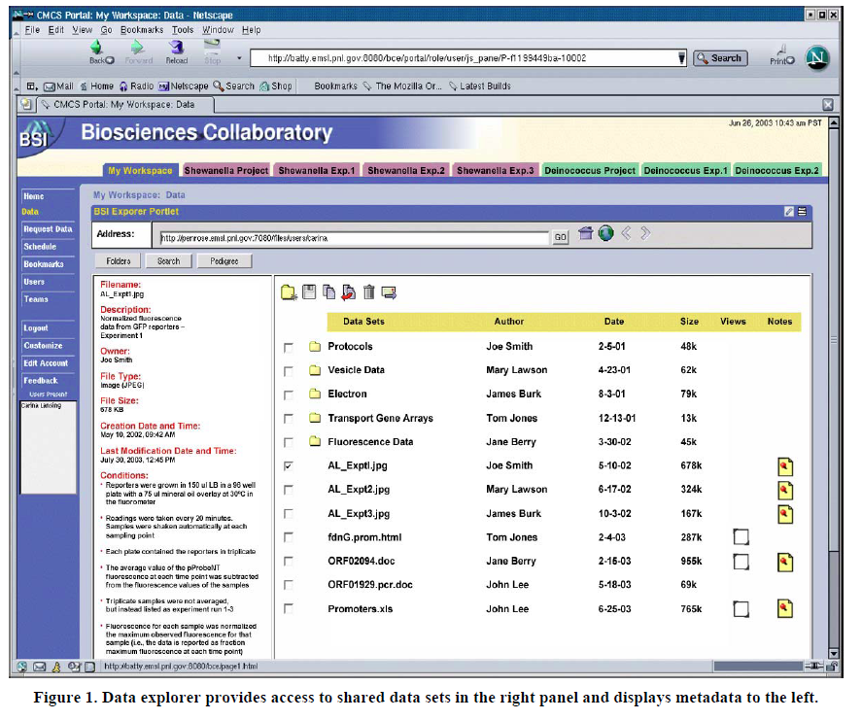
Basic Data Sharing with BSC
User interface through web-based portal
Supports a variety of formats – including various instrument data, spreadsheets, images, and publications.
Supports standard formats, schemas, and ontologies in biological science
  Micro-gene expression data society (MGED)
  Ensures interoperability with MGED-compliant archives

Slide 9
Basic Data Sharing with BSC
BSC provides data-translation tools
  BSC maintains a repository of such translation tools, including user-defined tools
  BSC can also identify translation paths between known formats, and semi-automatically apply them
Biologists can delineate projects in BSC using the tabbed interface.

Slide 10
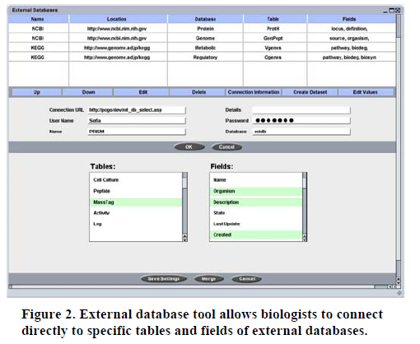
External Database Access
BSC has the capability to access external databases
  GeoBank, TIGR, KEGG, PubMed, etc.
  Provides standard database access tools
  When accessed, data query is executed and data transferred from databases to local copy in BSC
  Biologists can treat result of query as
    Either an isolated version
    Or maintain links back to DB
  Can have updates to data be done via notification or automatically
  Service subscription capabilities – securely place and retried data to/from BSC

Slide 11
Metadata
Meta-data associated with a dataset (generally constant – see figure on the right)
Meta-data associated with particular attributes (changes from experiment to experiment)
No mention of standardization of metadata (i.e. DublinCore)

Slide 12
Data Organization
BSC allows collaborative access and manipulation of shared data – regardless of where the data sets reside (flat files, database, etc.)
Provides active links to data sources
Viewer used to partition data based on different data-sets, sub-theories, or tasks assigned to team members (see example, next slide)

Slide 13
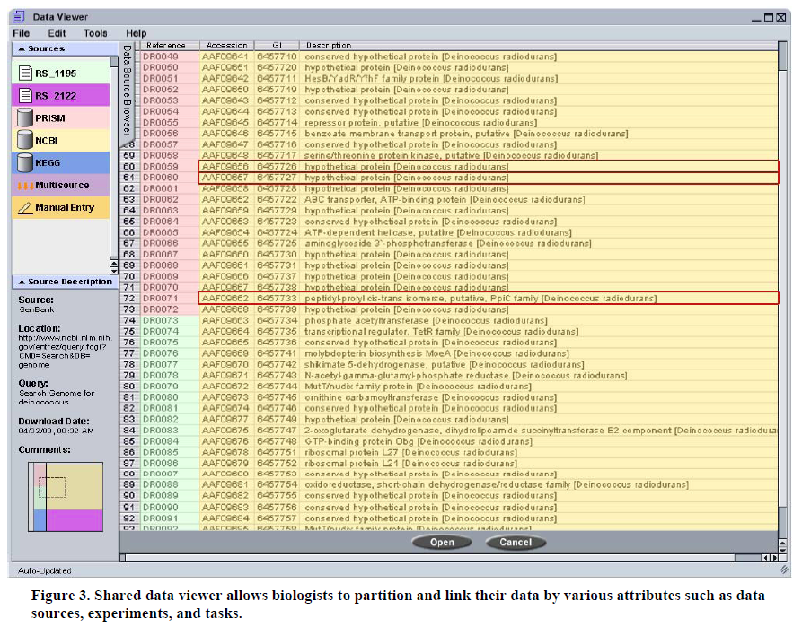

Slide 14
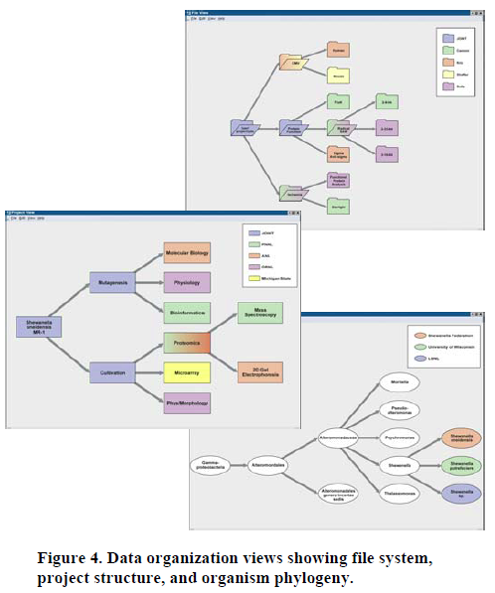
Additional data-viewing tools
  File system view just one type of view (top)
  Biologists may need other views
    Based on divisions of overall project (middle)
    Based on scientific organization (bottom) – i.e. by taxonomy of organism under study.

Slide 15
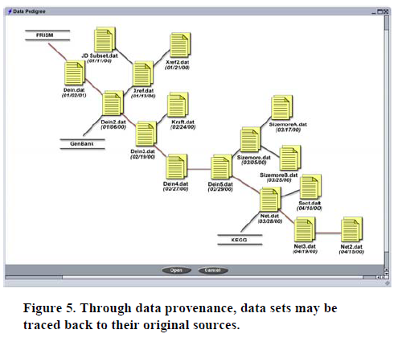
Data Provenance
As more experiments are run over a data set – historical version management becomes an issue
Data provenance tool depicts a tree for historical lineage of a data set
Allows comparisons of different versions and branches of the tree

Slide 16
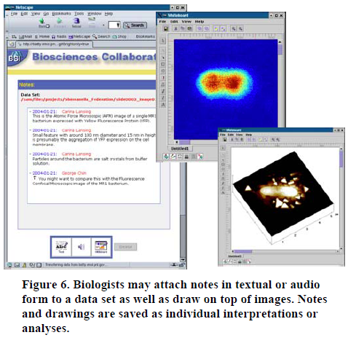
Collaborative Analysis
Collaborative analysis is a process of brainstorming where researches share their individual interpretations, understanding, and insights which build upon one another to form cogent findings and conclusions.
Facilitated in BSC by allowing electronic notes attached to data.
  Verbal
  Textual
  Markings on drawings/figures via different overlays

Slide 17
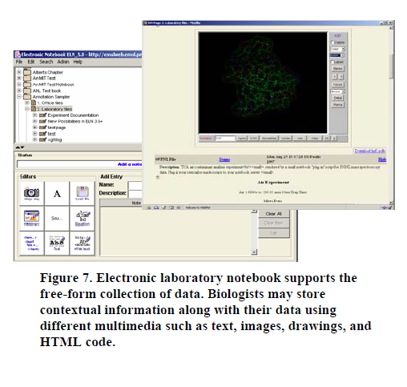
Collaborative Analysis
Also supported via a free-form electronic notebook
BSC also supports Collaborative Analysis by allowing researchers to share analysis and tools.
  Analysis results can be stored just like any other dataset
Also supports integration with teleconferencing packages

Slide 18
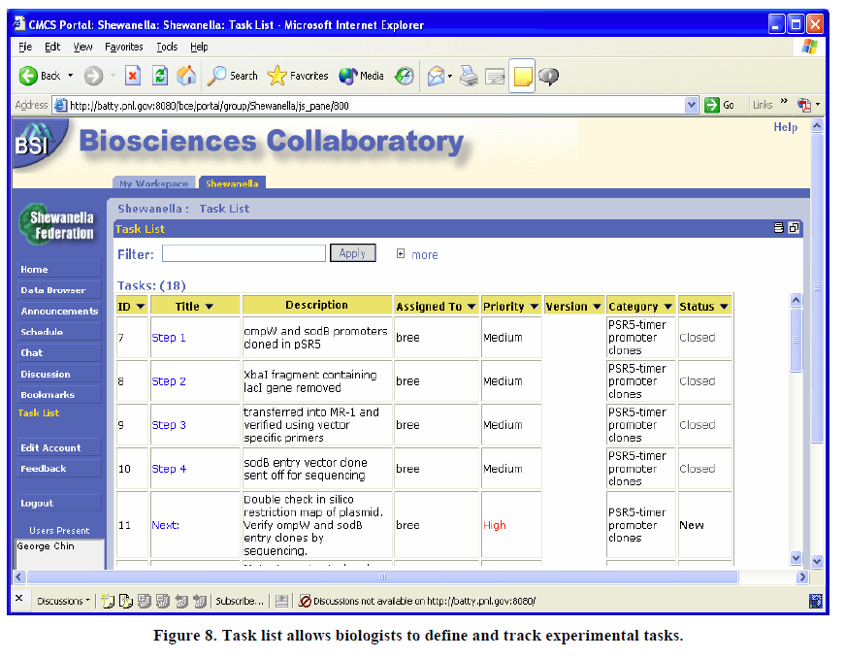
Task Management
BSC allows biologists to define and track experimental tasks.
PM’s may query task list in different ways

Slide 19
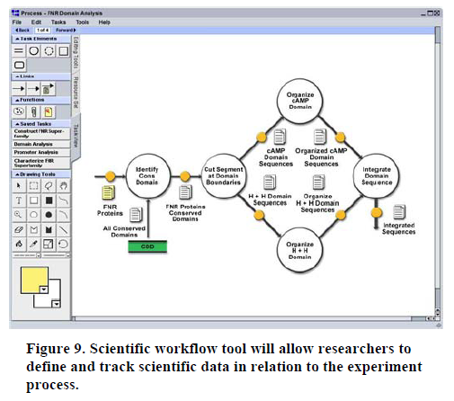
Task Management
BSC also provides workflow-management capabilities
Captures, manages, and supplies standard paths for analysis
Synchronized with task-list

Slide 20
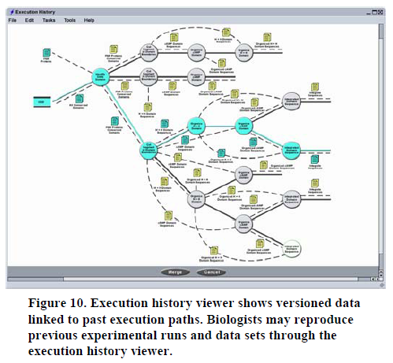
Task Management
Workflow tool allows biologists to work with and link combinations of analysis and visualization tools in useful and novel ways
  i.e. repetitively applying tools in a particular analysis or experiment
Execution history viewer allows biologists to highlight and re-instantiate particular paths of past workflow executions
Various authorization levels used to provide scientists cross-project access
Publication of data to larger scientific community also supported
  Automatic notification of updates
  General bulletin board service

Slide 21
Implementation
Based on Collaborator for Multi-scale Chemical Sciences (CMCS)
Written in Java, using Apache Jetspeed
Collaboration tools through Univ. Michigan’s CHEF
For content management, uses Scientific Annotation Middleware (SAM) (based on open source implementation of WebDAV protocol called Jakarta Slide)
Testbed deployed to a ground of biologists at PNNL and external biologists from the Shewanella Federation
One result of testbed: biologists need an organizing context when working with shared data sets – i.e. biologists need to see and understand relationships among datasets before they can be effectively shared
  Supported in BSC through free-form text

Slide 22
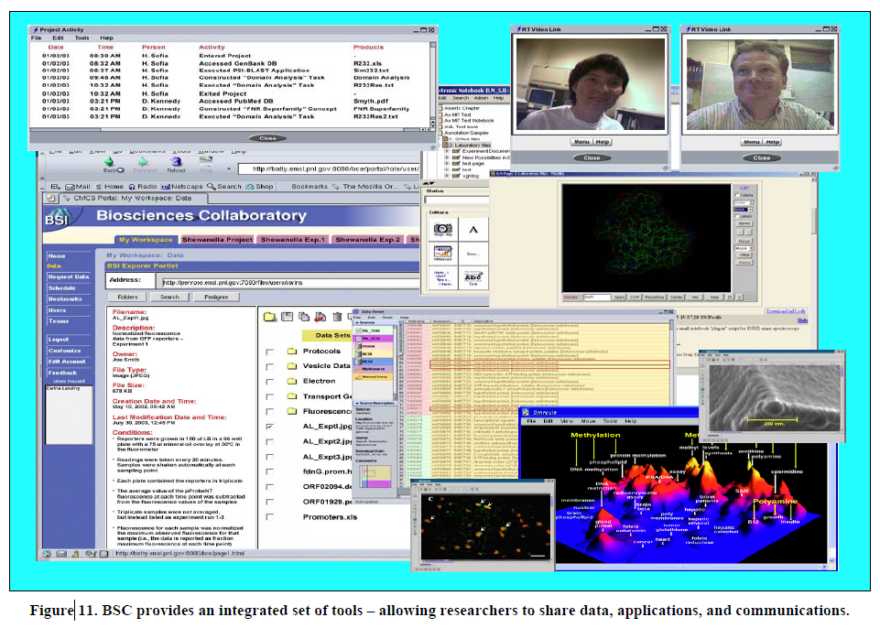

Slide 23
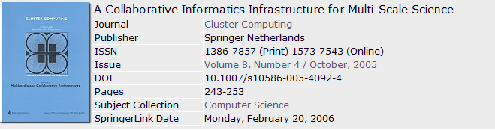
Related PNNL Publication
Abstract The Collaboratory for Multi-scale Chemical Science (CMCS) is developing a powerful informatics-based approach to synthesizing multi-scale information in support of systems-based research and is applying it within combustion science. An open source multi-scale informatics toolkit is being developed that addresses a number of issues core to the emerging concept of knowledge grids including provenance tracking and lightweight federation of data and application resources into cross-scale information flows. The CMCS portal is currently in use by a number of high-profile pilot groups and is playing a significant role in enabling their efforts to improve and extend community maintained chemical reference information.

Slide 24
Comparison with SIBDATA
Results pilot experiment provides interesting insights into scientific collaboration
Workspace, and differing options for links to external sources was something earlier discussed for SIBDATA
Data Provenance may be something worth looking into for SIBDATA
Workflow management and repetitive application of tools may also be useful for SIBDATA

Slide 25
Questions

